Slide 1

Bank Customer Churn Prediction
By :
Supriya Arunkumar
Notes:
Imagine being able to predict which customers are about to leave your bank – before they even think about it. Today, we're diving into how machine learning can help us do just that using EDA and ML techniques.

Slide 2

OVERVIEW
This project aims to develop an accurate customer churn prediction system for the banking industry to proactively retain the customers and mitigate the loss in revenue
Notes:
The banking sector is evolving rapidly and is very well influenced by technological advancements , changing consumer preferences , and a competitive market
Hence this project aims to develop an accurate customer churn prediction system.

Slide 3
WHAT IS CUTOMER CHURN
Customer churn refers to the loss of clients or customers who decide to stop using a company’s products or services
In banking, this means customers closing accounts or moving their assets to another financial institution
Notes:
What is Customer churn: Customer churn refers to the loss of clients or customers who decide to stop using a company’s products or services. Particularly In banking, this means customers closing accounts or moving their assets to another financial institution

Slide 4
PROBLEM
Customer churn is a critical issue for banks, leading to revenue loss and potential damage to brand reputation. By identifying and predicting the factors driving customers to leave, banks can proactively address these issues to retain valuable clients
Notes:
Customer churn is a critical issue for banks, leading to revenue loss and potential damage to brand reputation. By identifying and predicting the factors driving customers to leave, banks can proactively address these issues to retain valuable clients

Slide 5

DATA DRIVEN INSIGHTS
Notes:
Now let’s look at different data visualizations which aids to gain a comprehensive overview of the different factors influencing a customer’s decision.

Slide 6
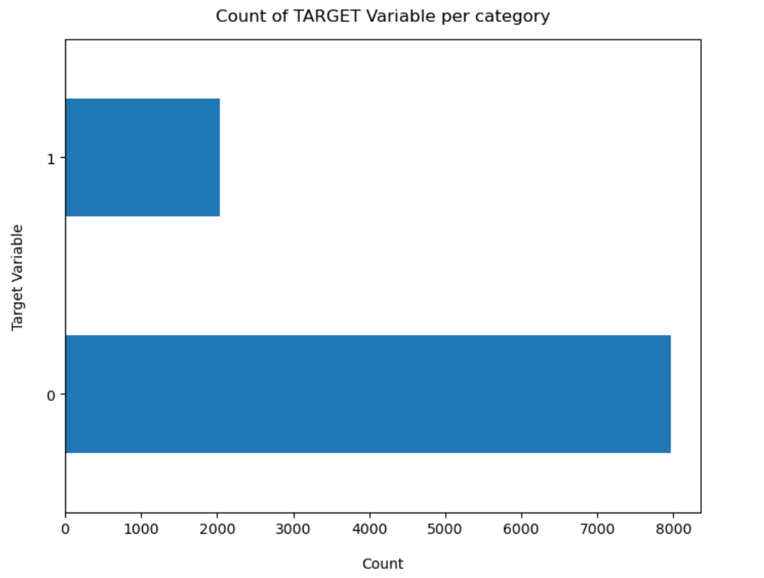
Distribution of Customer Churn:
Analyzing the proportion of customers who have exited the bank vs. those who have stayed
Notes:
This bar graph shows the distribution of customers remained with the bank and customers exiting the bank . Here 0 denotes the customers who are still associated with the bank and are in a majority as you can see and 1 denoting the customers who have discontinued their relationship with the bank or exited.

Slide 7
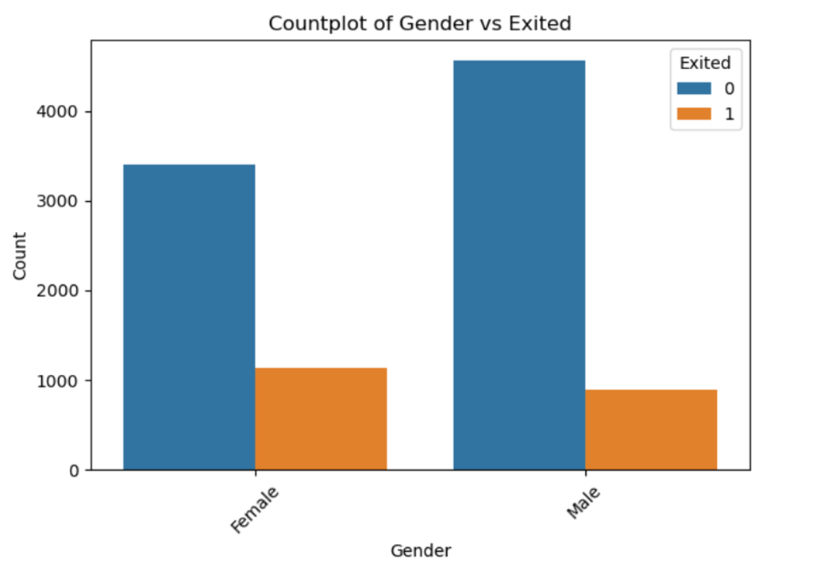
Churn Distribution Across Genders:
Highlights the difference in churn rates between male and female customers
Notes:
Churn Distribution Across Genders: Visualizes the relationship between gender and churn to identify if one gender has a higher exit rate than the other.

Slide 8
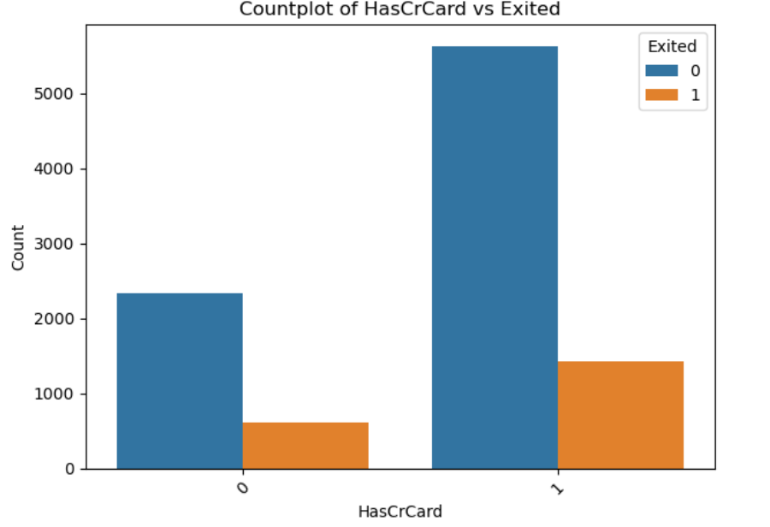
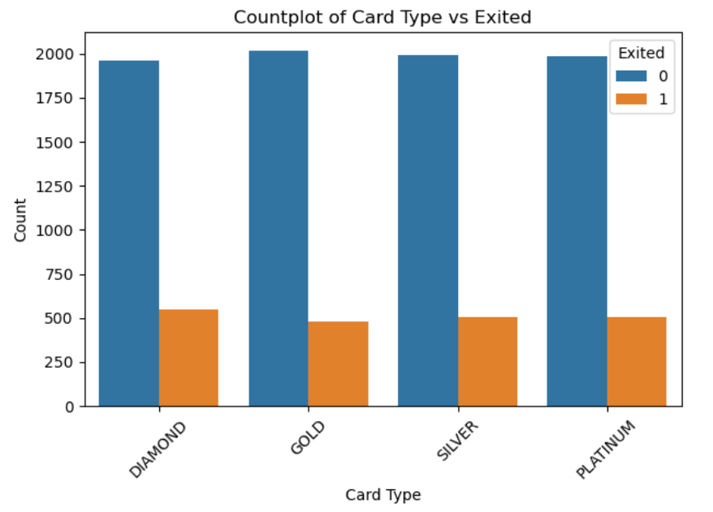
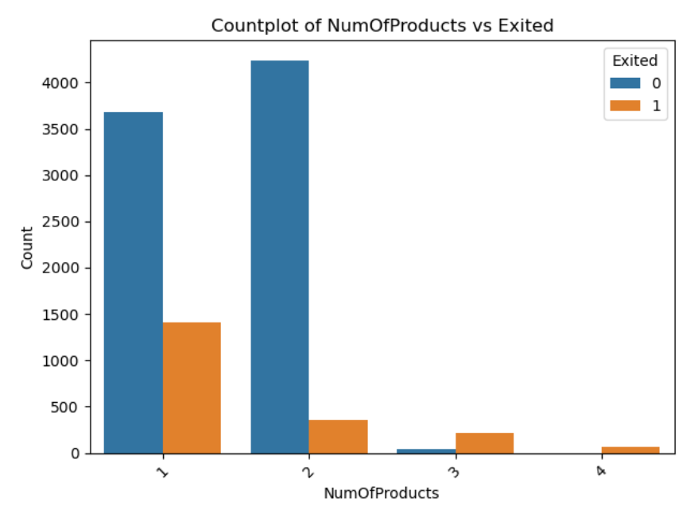
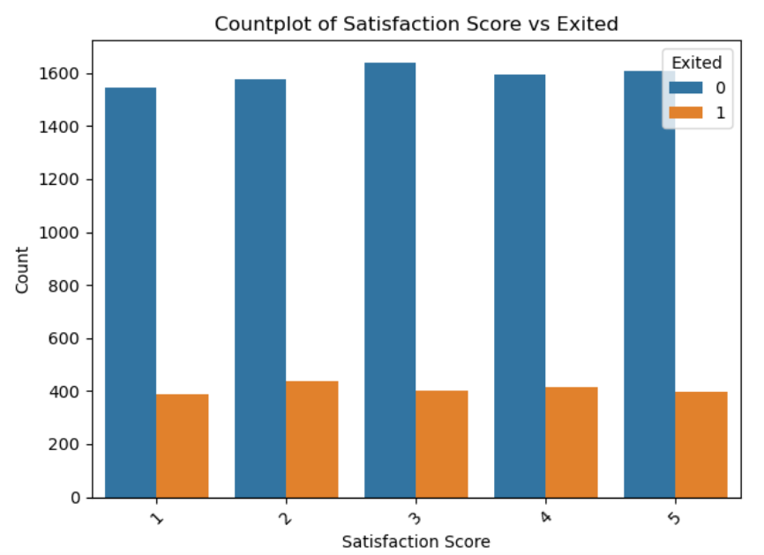
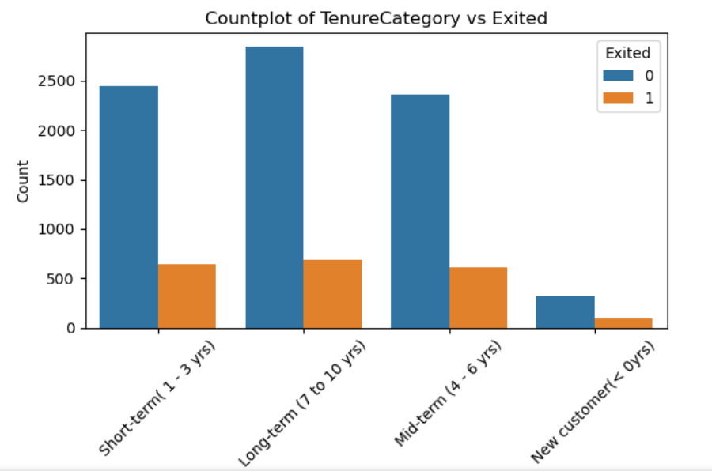
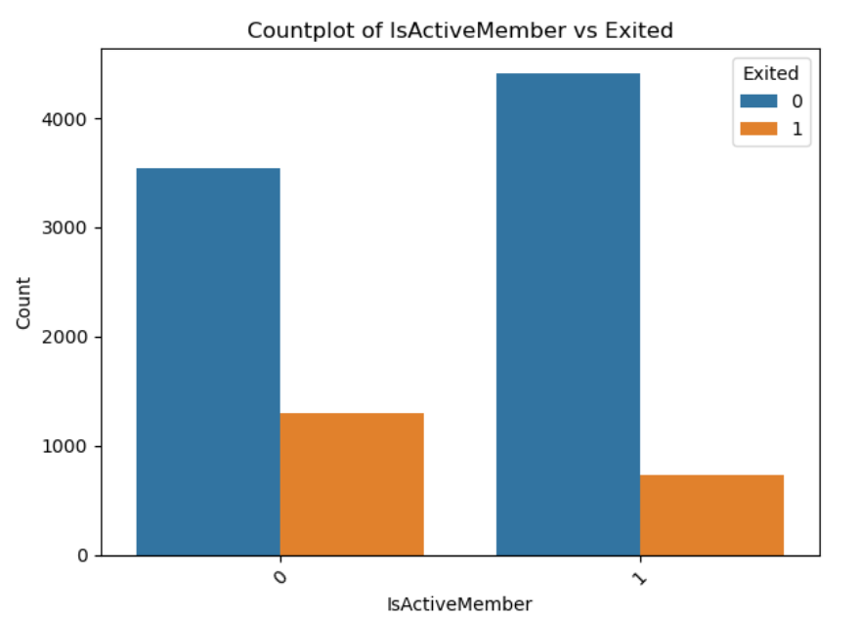
Feature Analysis by Customer Churn
Notes:
This analysis highlights how various customer characteristics, such as tenure, satisfaction, and product usage, correlate with customer churn. Each plot helps us understand whether certain customer attributes might contribute to an increased likelihood of exiting."

Slide 9
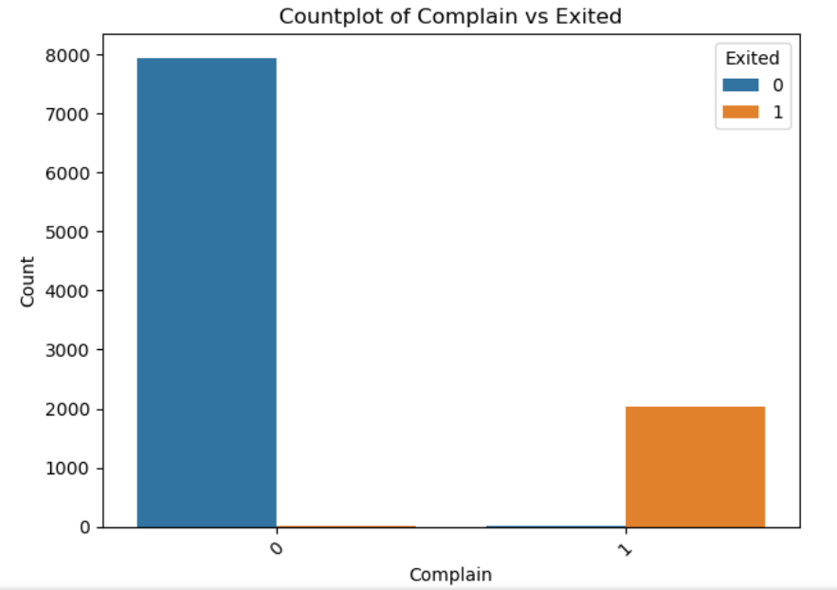
Impact of Customer Complaints on Churn
Highlights how customers who have registered complaints are more likely to churn compared to those who have not
Notes:
This plot examines the influence of customer complaints on churn rates. Understanding this relationship is essential, as complaints often indicate dissatisfaction, which can drive customers to leave. The graph also highlights how customers who have registered complaints are more likely to churn compared to those who have not

Slide 10
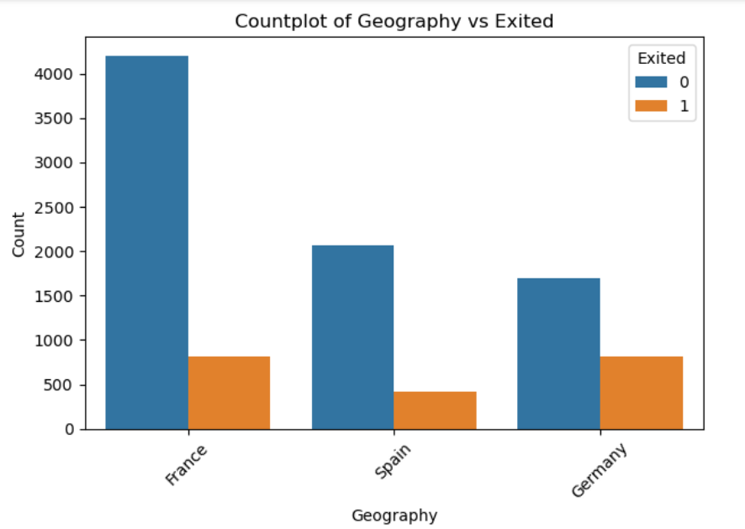
Churn Rates Across Different Countries
Notes:
While this countplot provides a high-level view, we need a more detailed and interactive analysis to uncover actionable insights for each region. To understand country-specific data, I would like to show you an interactive dashboard that allows us to explore and compare customer churn metrics

Slide 11

APPLYING MACHINE LEARNING ALGORITHMS
Notes:
Our main goal was to identify patterns in customer behavior to predict churn accurately.By doing so, we can proactively engage at-risk customers and reduce churn rates.

Slide 12
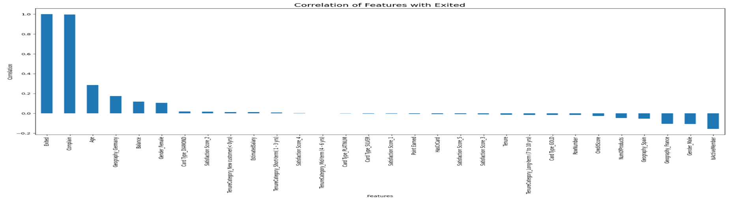
Key Drivers of Customer Churn
Top Predictors of Churn: Customer complaints, age, and location (Germany) strongly correlate with churn.
Weak Predictors: Factors like estimated salary, credit score, and certain satisfaction scores show minimal impact on churn.
Retention Insight: Active membership has a negative correlation, indicating active customers are more likely to stay.
Notes:
Key Drivers of Customer churn: This countplot shows top predictors of churn include customer complaints, age, and location (Germany), which show a strong correlation with customer exit. In contrast, active membership is negatively correlated, suggesting that engaged customers are more likely to remain.

Slide 13
Methods Used:
Logistic Regression
Used as a baseline model for binary classification
Evaluated using cross-validation and classification metrics
Decision Tree Classifier
Provides an intuitive approach by creating decision rules to classify customers
Useful for understanding the relative importance of features in predicting churn
Random Forest Classifier
Ensemble method that builds multiple decision trees for better accuracy and stability
Helps to capture complex patterns with reduced overfitting compared to a single decision tree
XGBoost Classifier
Gradient boosting model known for high performance in structured data
Achieved the highest accuracy in our evaluation
Efficiently handles missing values and provides fine-grained control over training
Notes:
Applying Machine Learning Algorithms: I tried testing four models: Logistic Regression, Decision Tree, Random Forest, and XGBoost, using cross-validation for reliability. XGBoost outperformed with the highest accuracy of 99%, effectively capturing complex patterns in customer data. Evaluation metrics confirmed XGBoost's robustness, making it the top choice for predicting customer churn.

Slide 14
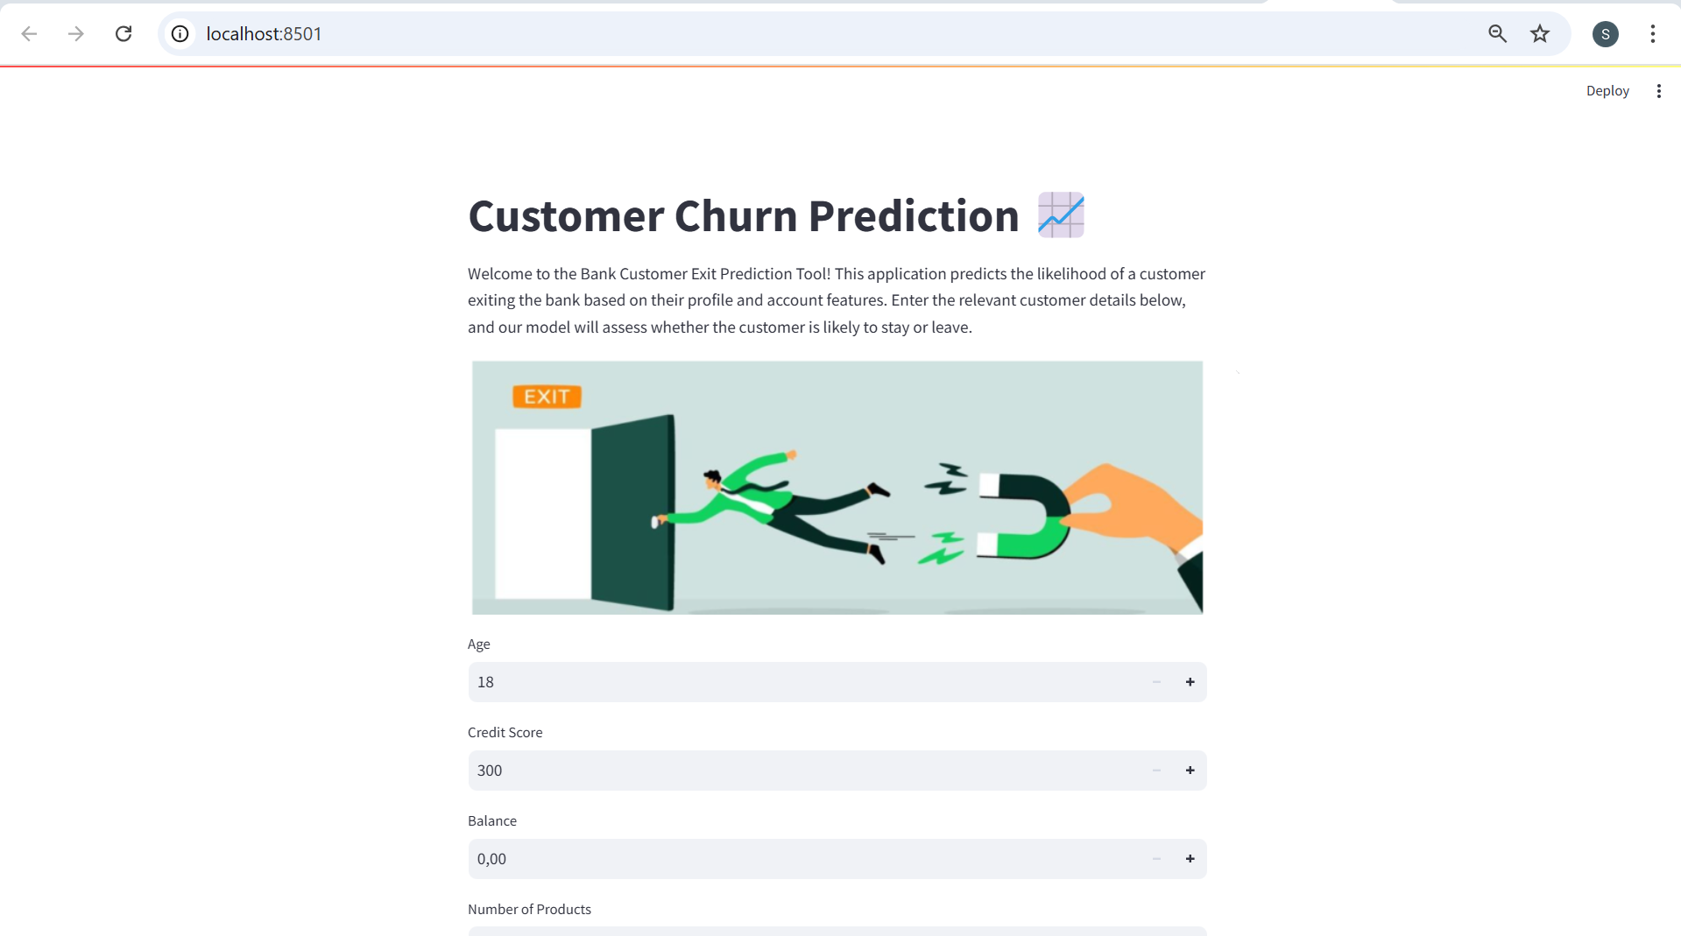
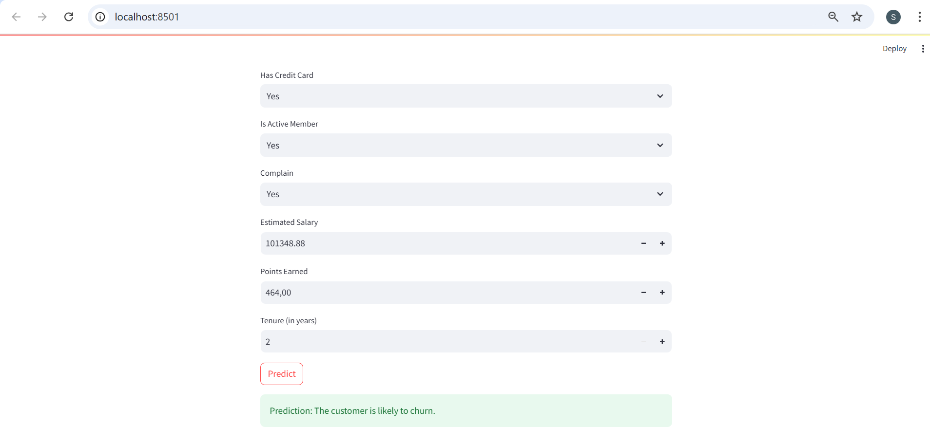
Interactive Customer Churn Prediction Tool
Purpose:
Real-time Churn Prediction for Bank Customers
Built with:
Streamlit for an intuitive user experience
Features:
User inputs customer data to predict churn probability
Visualizes prediction results and key insights
Provides actionable recommendations for retention
Notes:
To help the bank administration team , here I have come up with interactive churn prediction dashboard using Streamlit, allowing for real-time customer churn predictions. Users can input individual customer data, such as account information and behavioral metrics.The dashboard instantly predicts whether a customer is likely to churn and displays the probability score. This tool helps teams make data-driven retention decisions quickly.Its intuitive interface ensures that even non-technical users can leverage machine learning insights.

Slide 15
RECOMMENDATIONS
Design targeted strategies to keep customers engaged
Train teams to address customer needs proactively
Create rewards and incentives to increase customer loyalty
Notes:
Here are a few recommendations on how to reduce the churn rate

Slide 16
Thank you
By : Supriya Arunkumar

